Slide 1


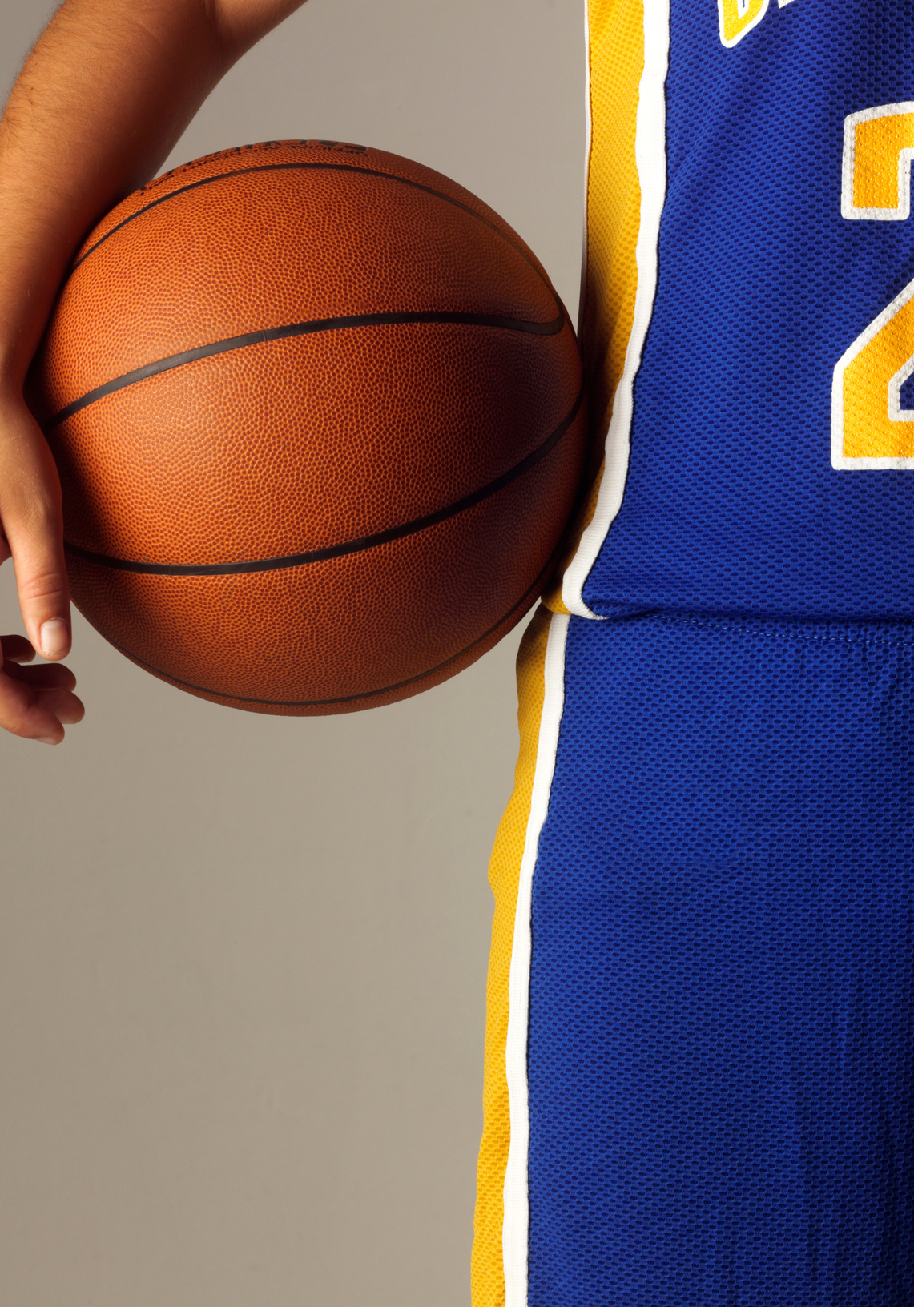
AI-DRIVEN
SPORTS MANAGEMENT PORTAL
CSIS4495 APPLIED RESEARCH PROJECT
SECTION 002
PRESENTED TO: PADMAPRIYA ARASANIPALAI KANDHADAI
PRESENTED BY: JUAN CARLOS KATIGBAK 300366535

Slide 2
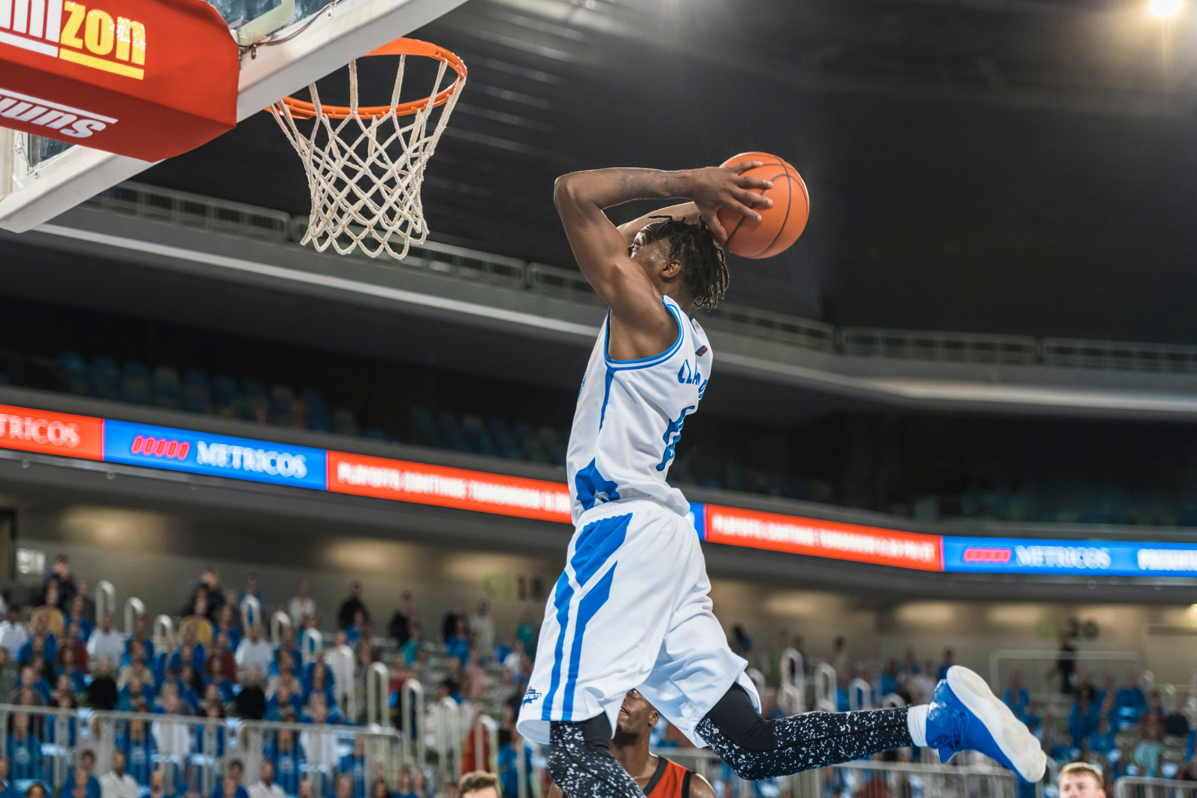
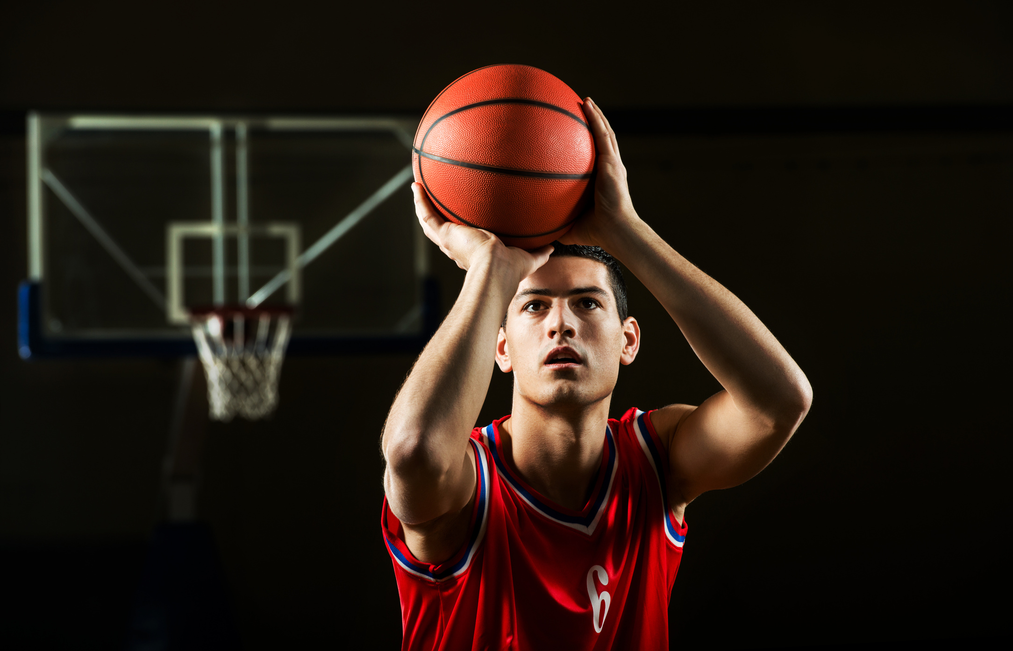




THE PROBLEM IS MORE THAN
JUST A GAME
How can ML improve injury prediction and performance optimization in sports?
What methods can provide data-driven insights for athletes?

Slide 3

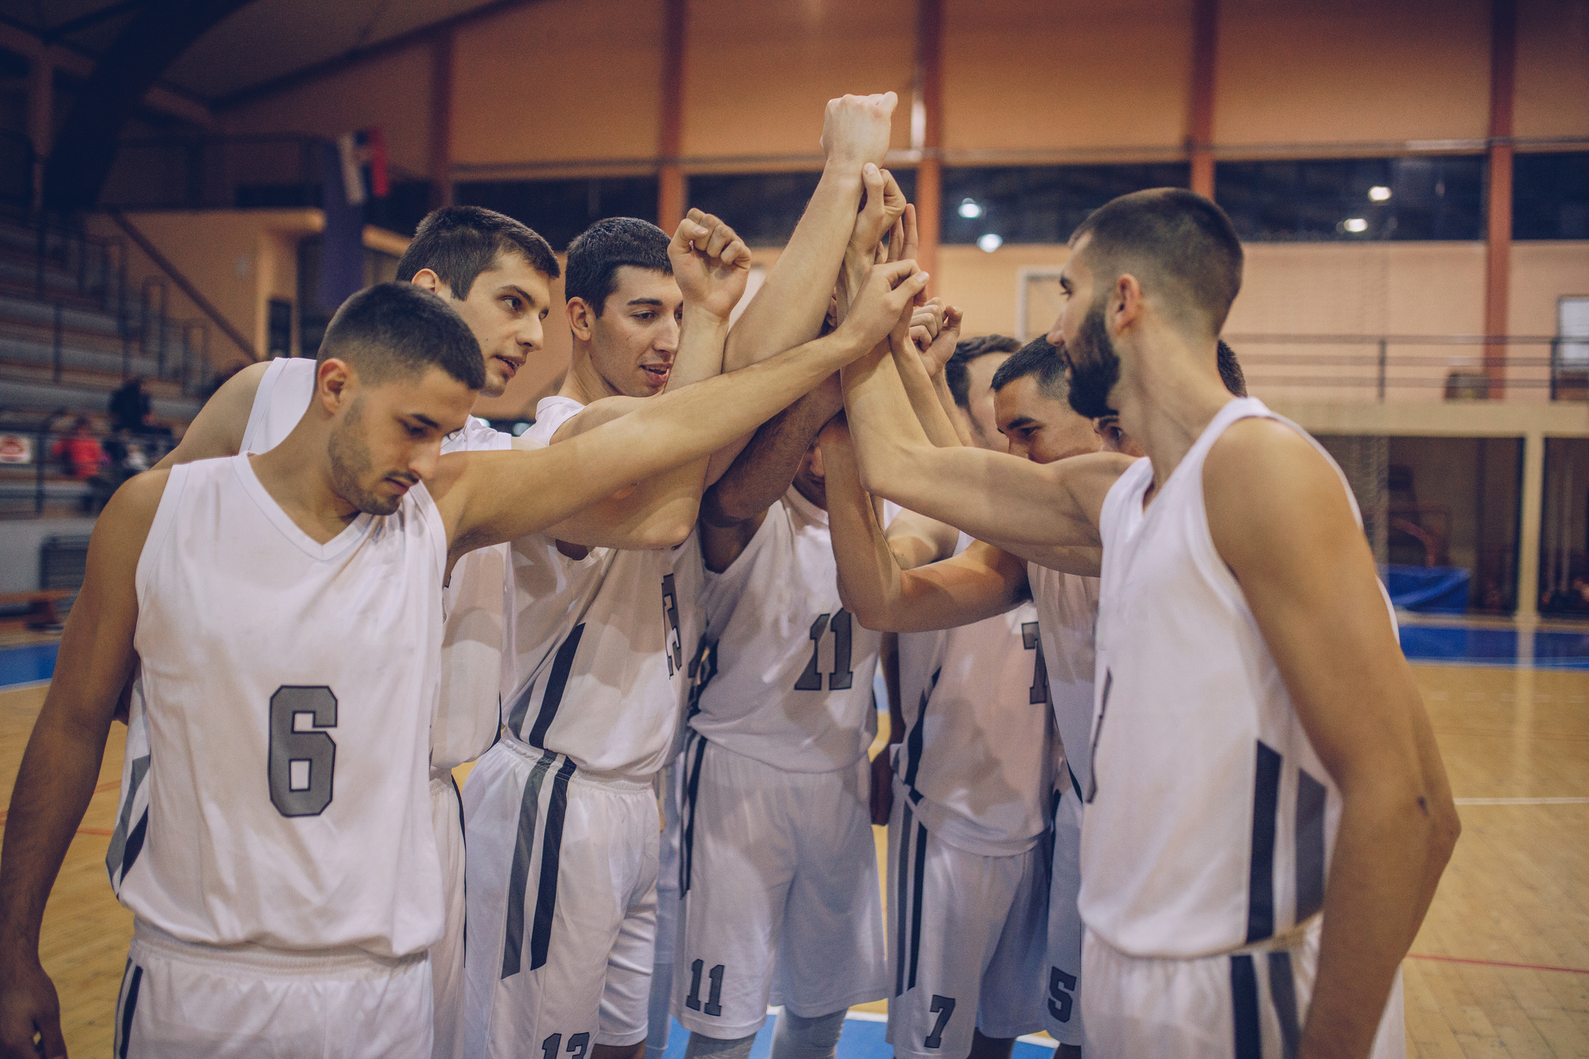

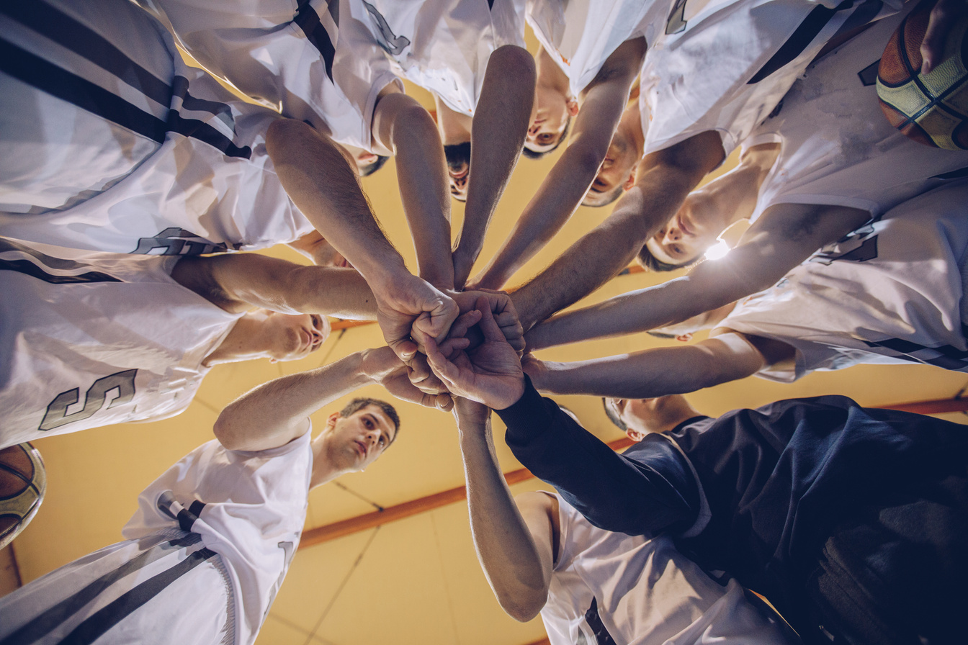


RESEARCH DESIGN
AND OBJECTIVES
Develop a web-based sports management portal utilizing machine learning to predict injury risks and deliver data-driven insights tailored specifically for basketball athletes.
Objectives
a. Create a database to store athlete profiles and performance metrics.
b. Train a machine learning model to predict injury risks using historical data.
c. Build interactive dashboards for visualizing injuries and injury risk level.

Slide 4

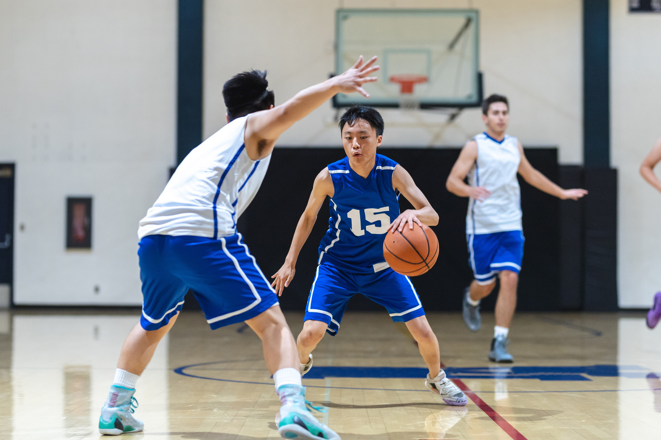



TECHNOLOGY STACK
From backend to frontend, ML to tools, every tech stack has purpose.
Backend: Django
Frontend: Bootstrap 5, Chart.js
ML: scikit-learn, Pandas, Numpy, Joblib
DB & Images: SQLite, Pillow
Tools: GitHub, Jupyter Notebook, Canva, ChatGPT, YouTube

Slide 5

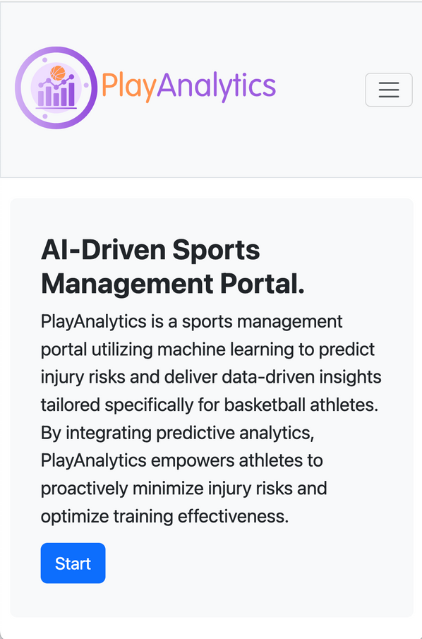
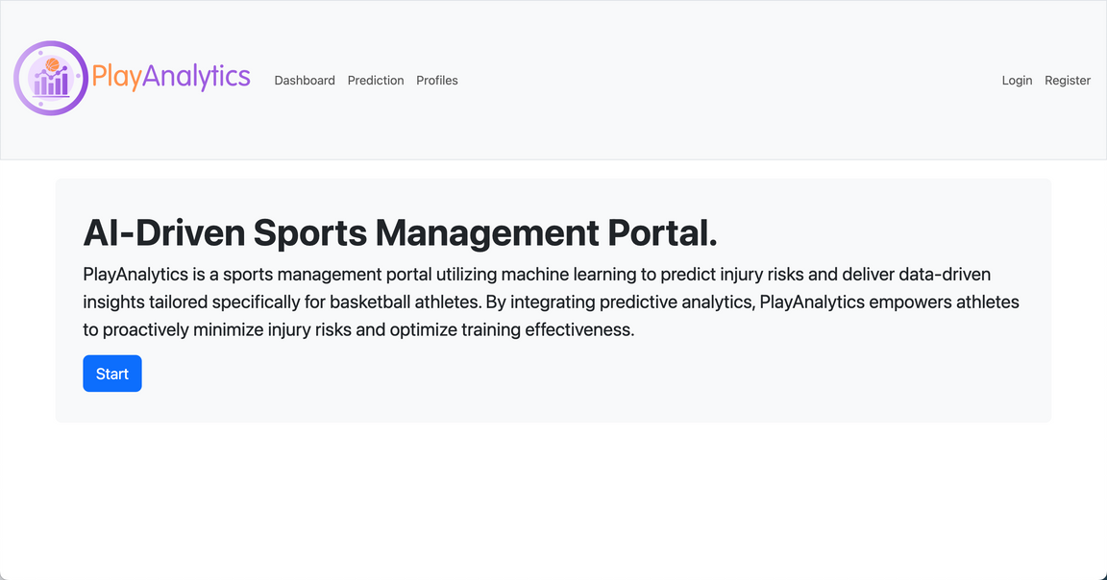

FEATURES
OVERVIEW
1. Responsive Web Design

Slide 6
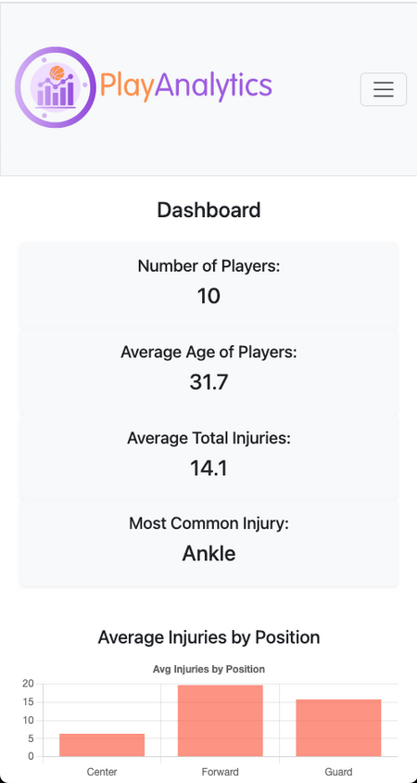
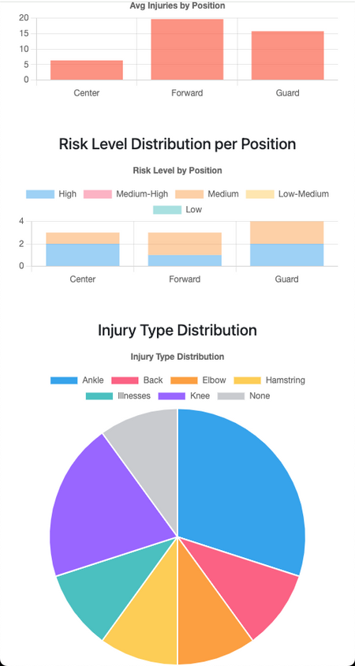
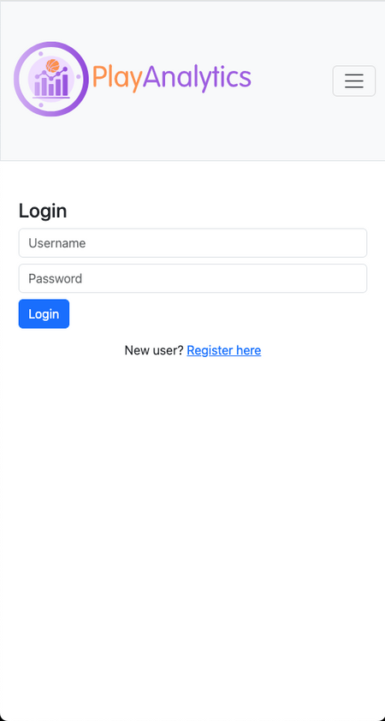
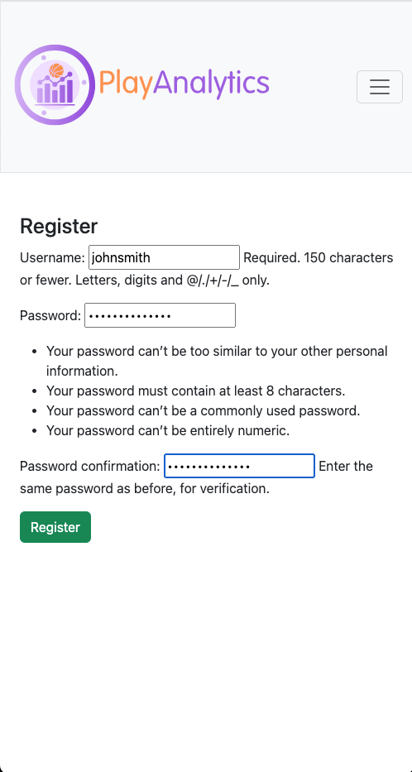
2. User Registration/Login
3. Dashboard Page

Slide 7
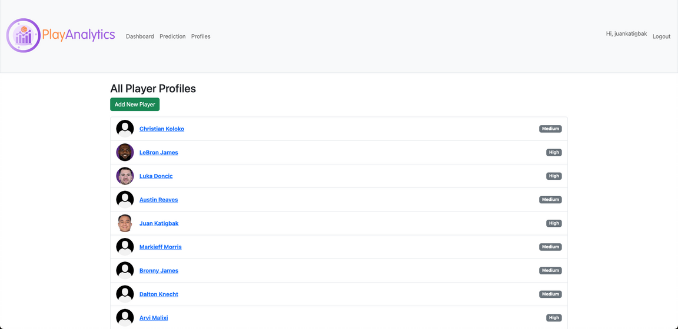
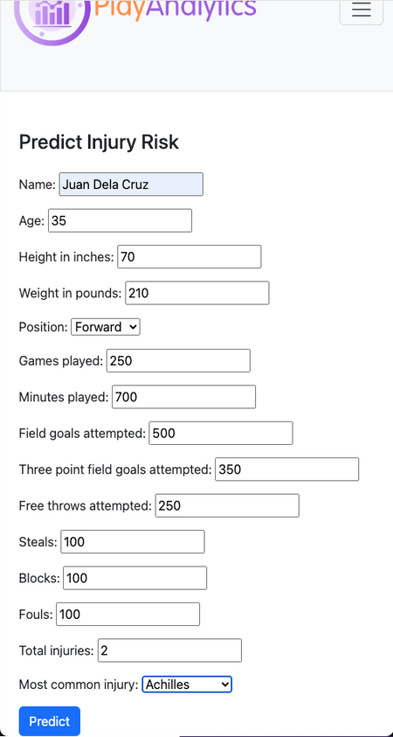
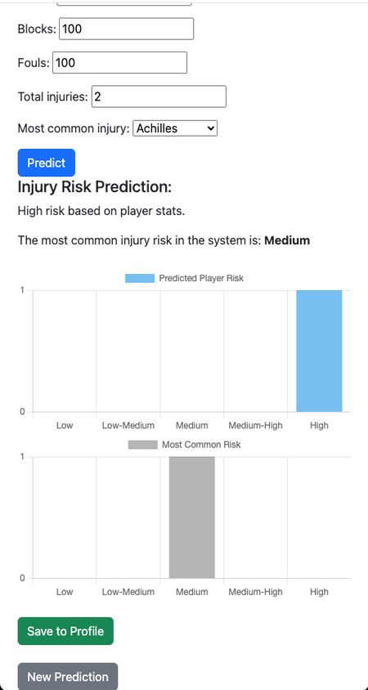
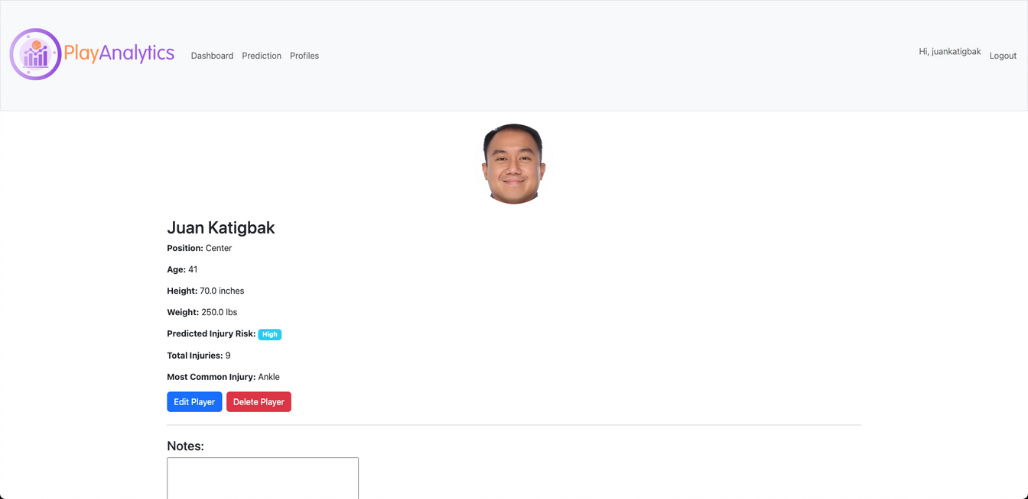
4. Prediction Page
5. Profile Page

Slide 8
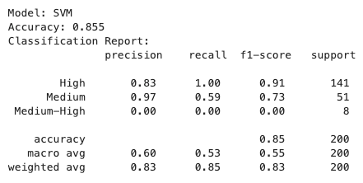
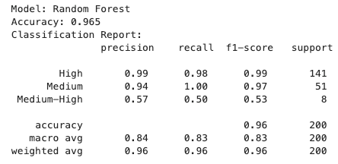
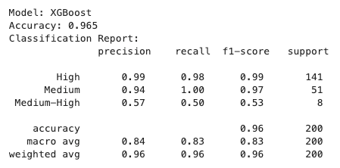
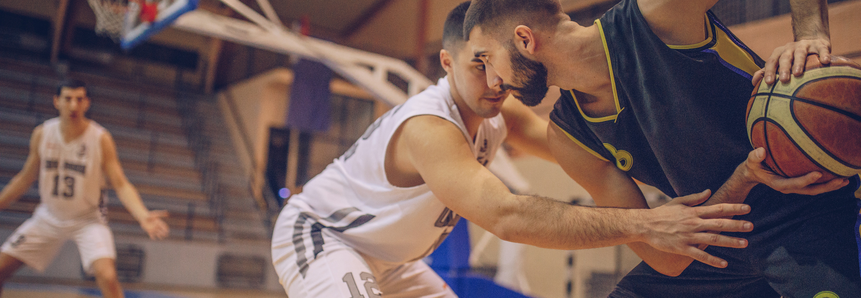
MACHINE LEARNING MODEL
Random Forest selected over SVM and XG Boost
Trained on 1000-player dataset
Accuracy: 96.5%

Slide 9


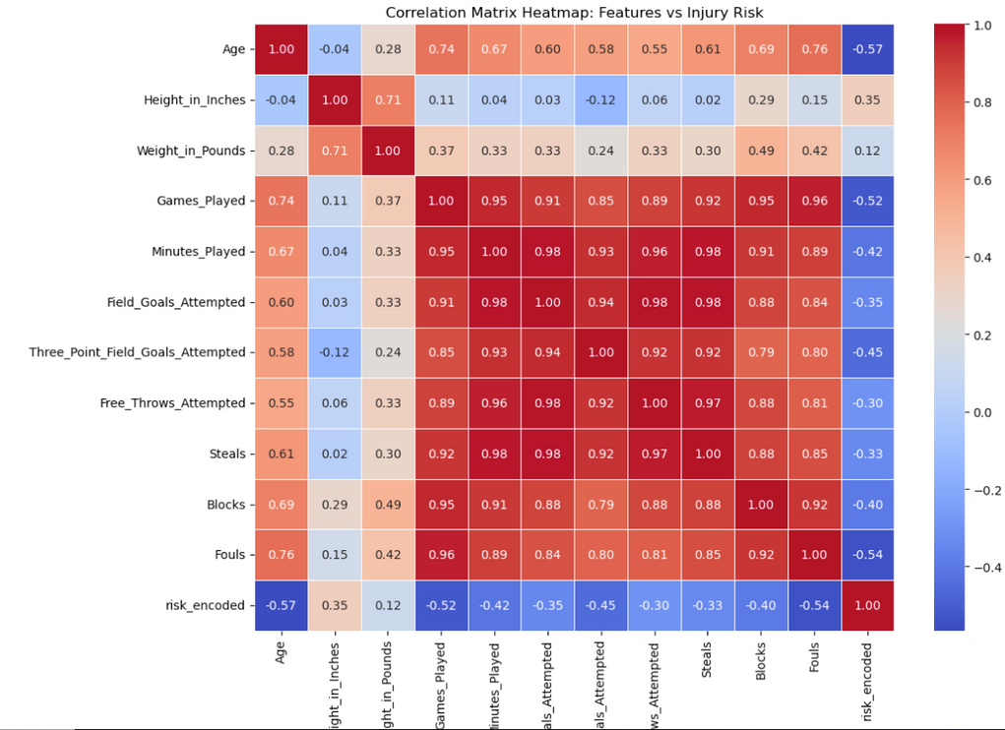
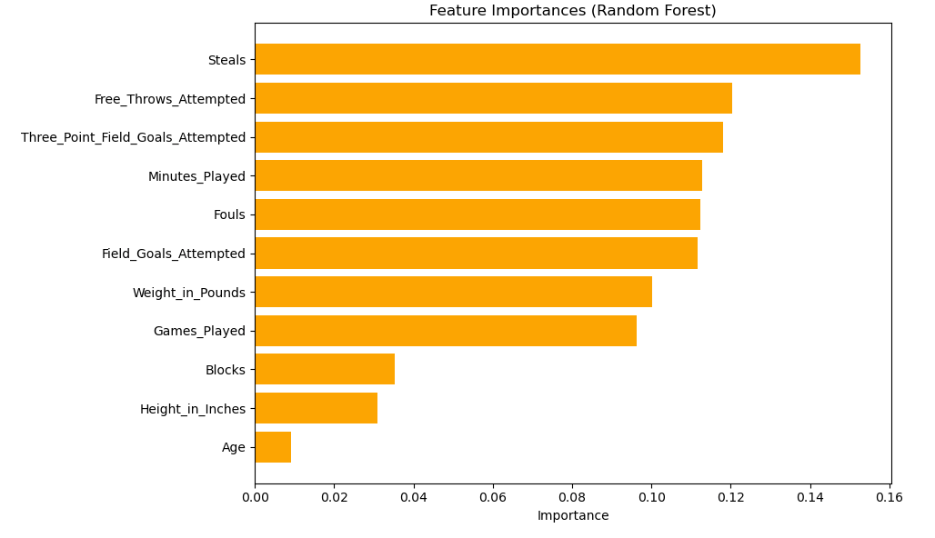
FEATURES
Key predictors: Steals, 3P Attempts, FT Attempts

Slide 10
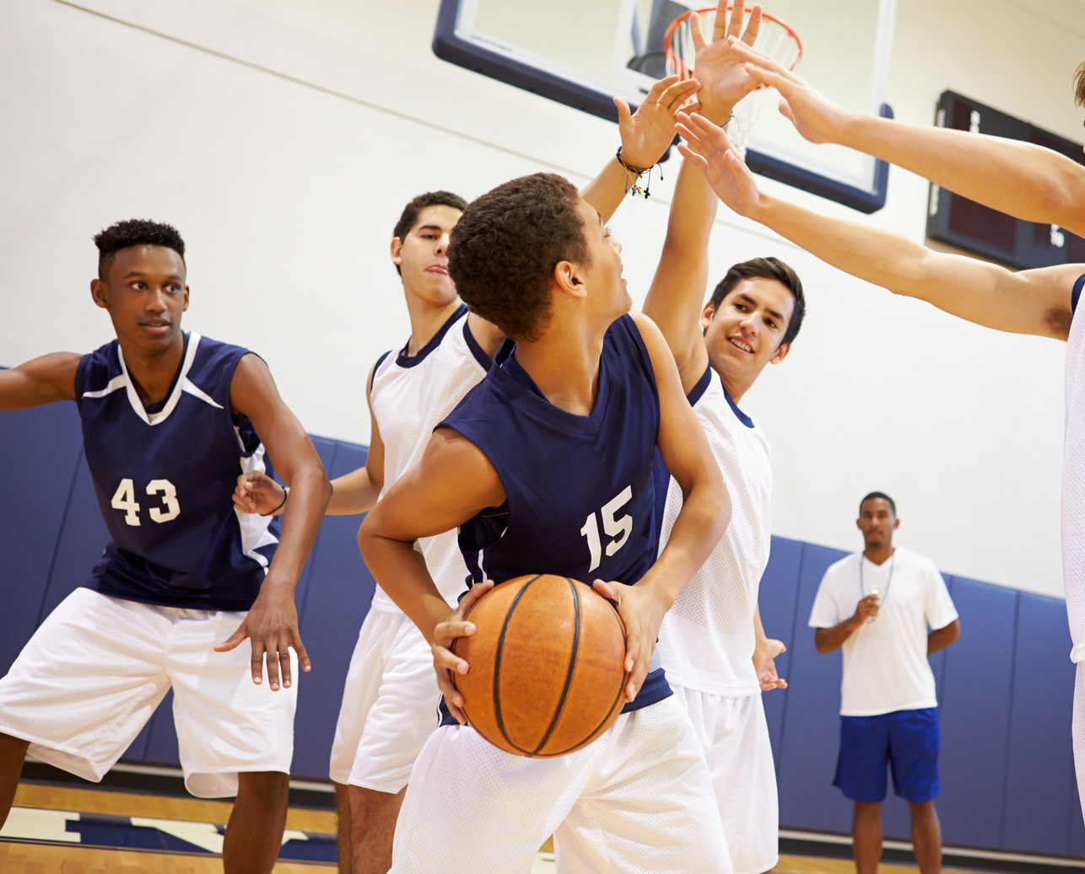
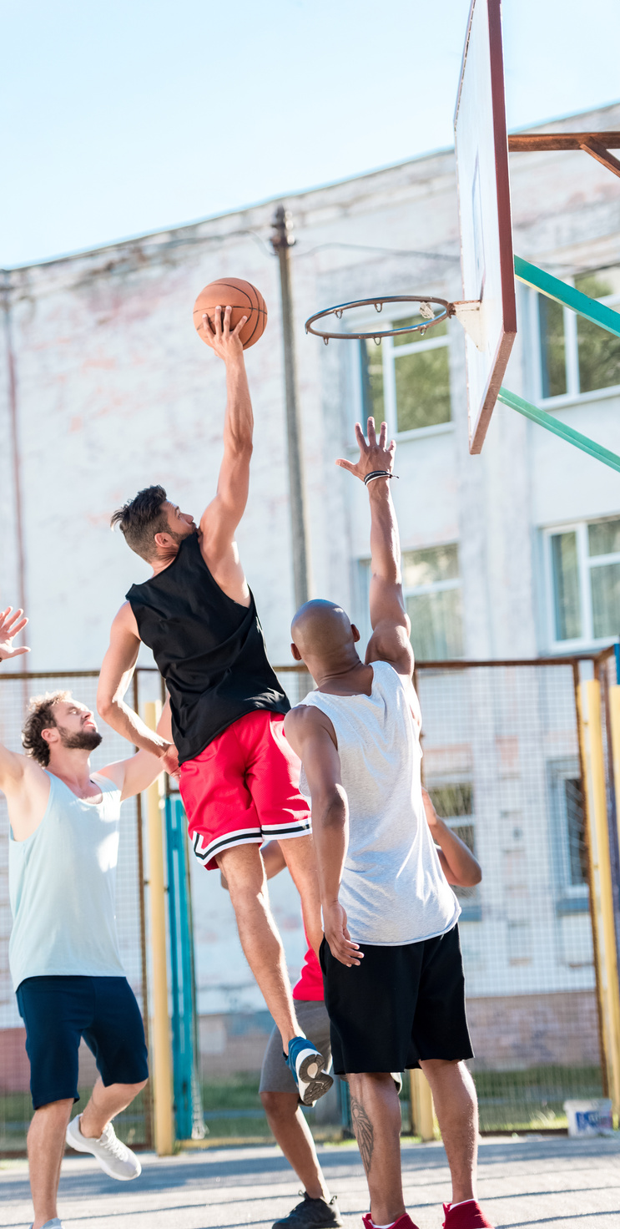
USER FEEDBACK
01
Overall rating: 4.65/5
SUMMARY
02
Dashboard: 15 of 17 found visuals useful
03
Prediction: 14 of 17 found predictions helpful
04
Profiles: 16 of 17 liked journal & stats

Slide 11

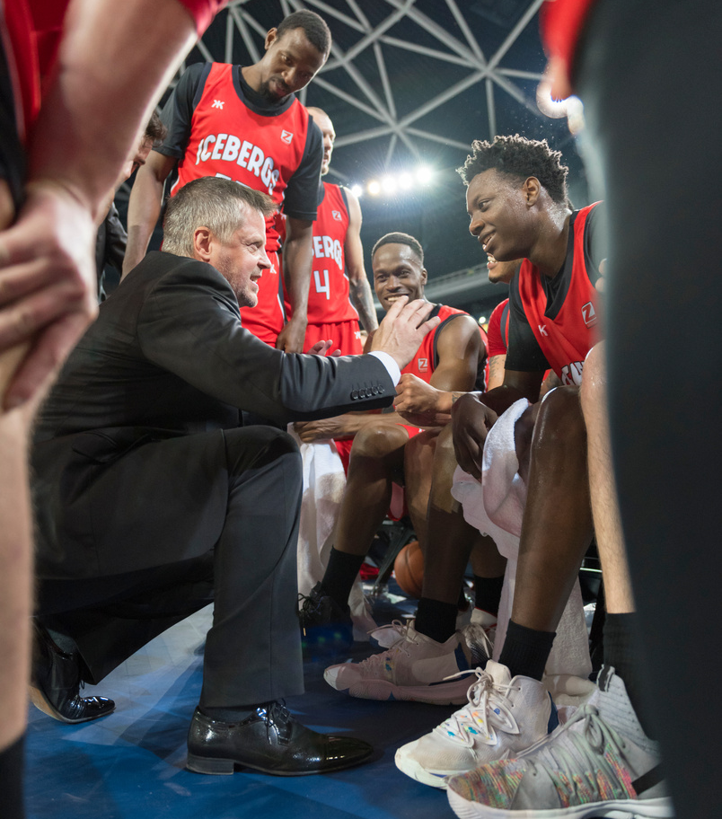

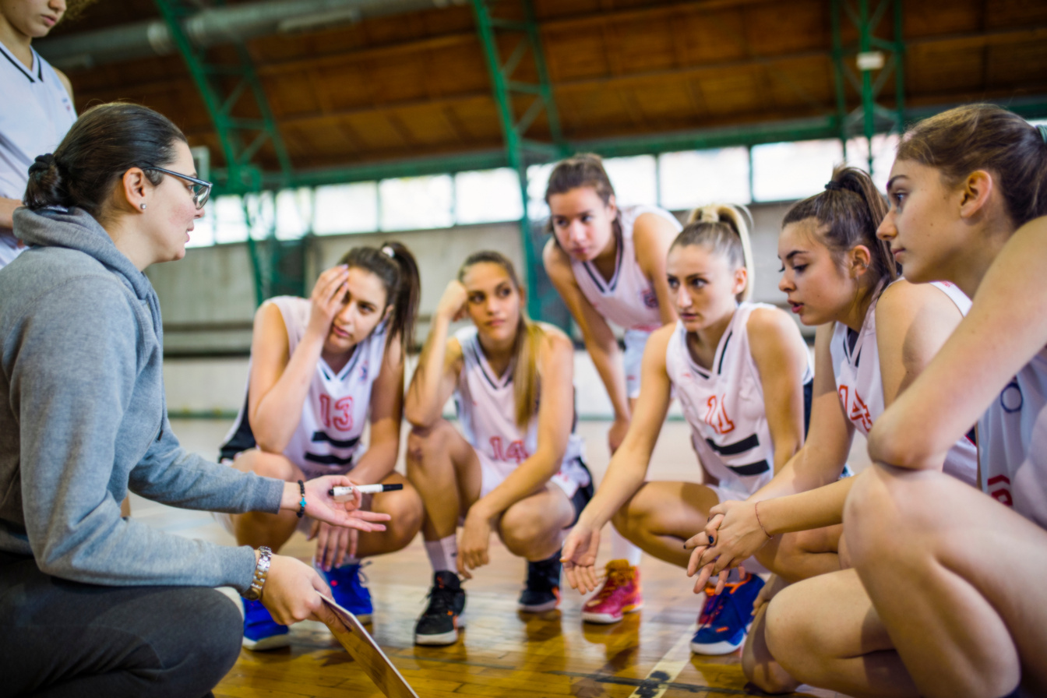

CHALLENGES
FACED
Limited prior ML experience
Finding clean NBA datasets
Overfitting and class imbalance
Rebuilding MVP based on advisor feedback
Full-stack development experience
ML model building & evaluation
Survey creation and user testing
Integrating software engineering and data analytics
WHAT
I LEARNED

Slide 12

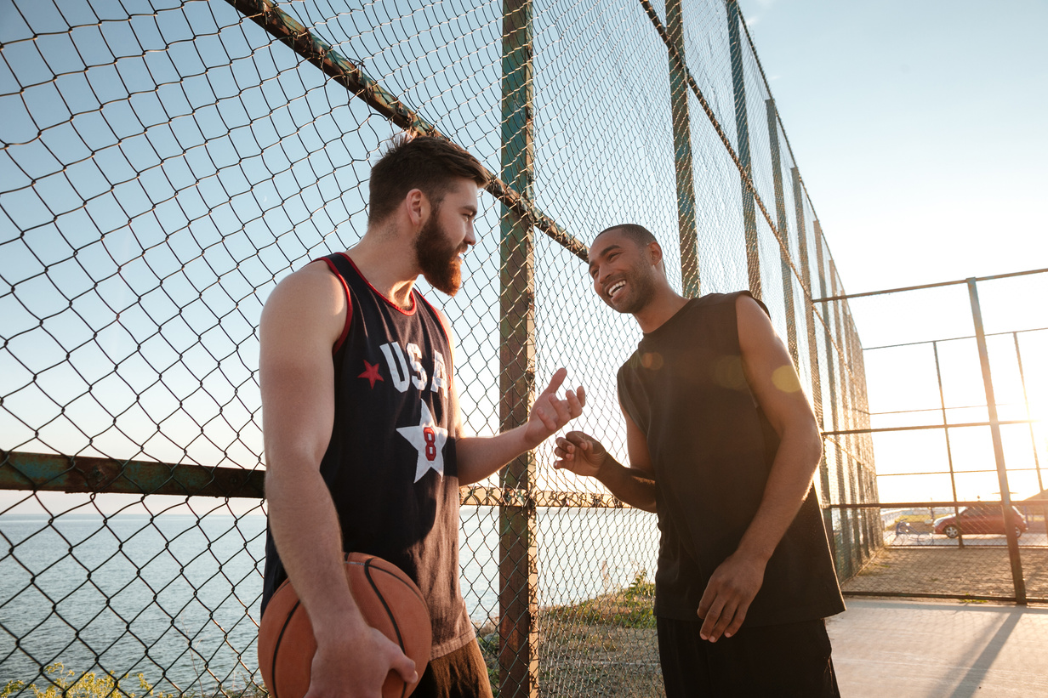

CONCLUSION
AND FUTURE PLANS
PlayAnalytics = Successful MVP
Scalable to more sports and fitness activities
Future ideas: Training module, more player metrics

